Slide 1
Interactive map for people with mobility limitations Anna Krys, Daria Aksionova, Timur Samoylov Ukraine, Belarus

Slide 2
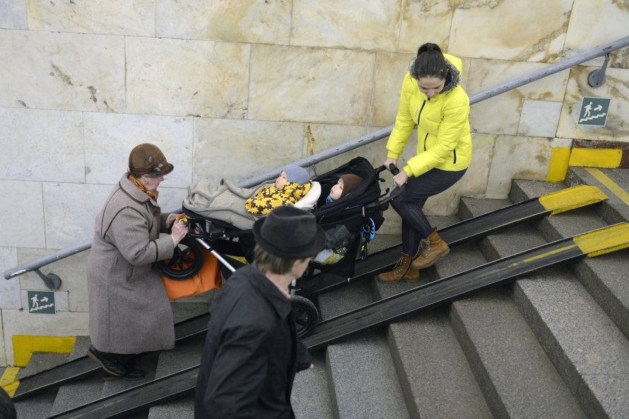
In Ukraine constructed improperly
е
90%
of ramps
Course on inclusivity has started in 2019
Association Agreement with EU, UN Convention on the Rights of Persons with Disabilities

Slide 3
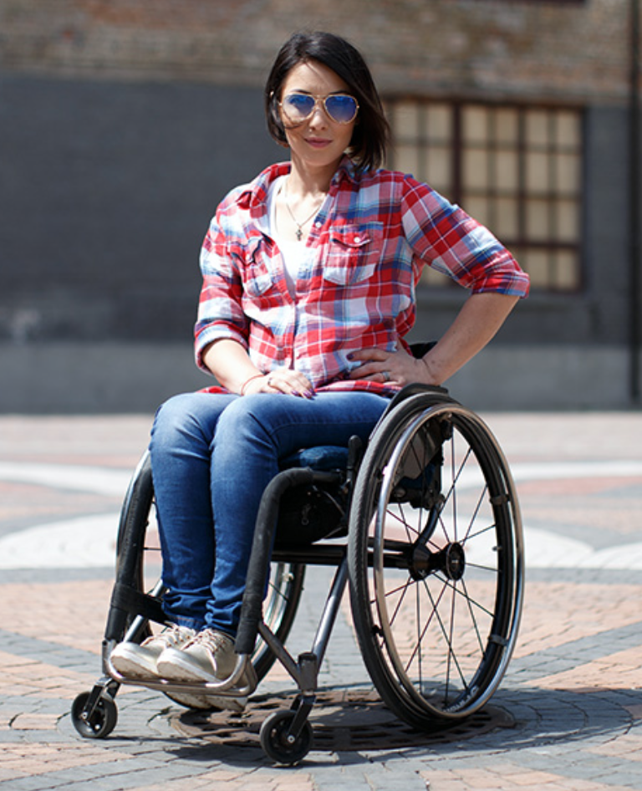
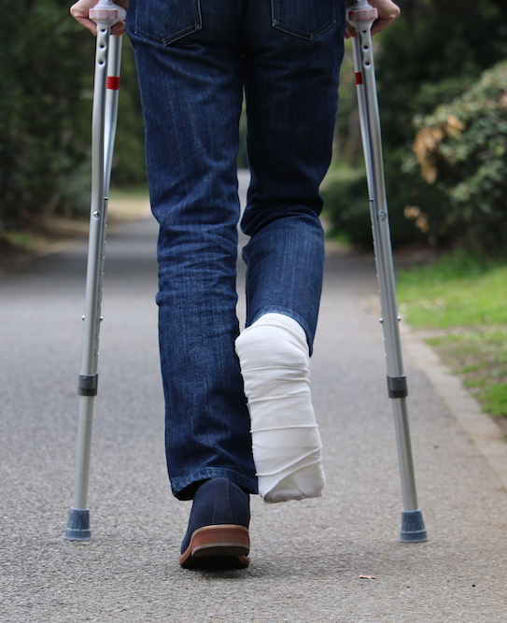
Target audiences

Slide 4
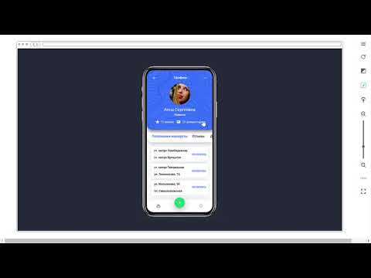

Slide 5
Roadmap
Add on map places (spots) with and without necessary inclusive infrastructures
Rate accessibility of places (spots)
depending on accessibility level
Gamification & reward programme
Crowdfunding
CSR Businesses
Accessible Route directions from point A to B
with mentioning (1) of its accessibility level for people with mobility limitations, (2) estimated time of arrival
Stage 2
Stage 4
Stage 6
Stage 1
Stage 3
Stage 5
Google Partnership
Automatic requests to government bodies Audit of popular city routes
Checklist for audit
Offline meetings
Architectural inclusive challenge
International forum about inclusion for EaP countries

Slide 6
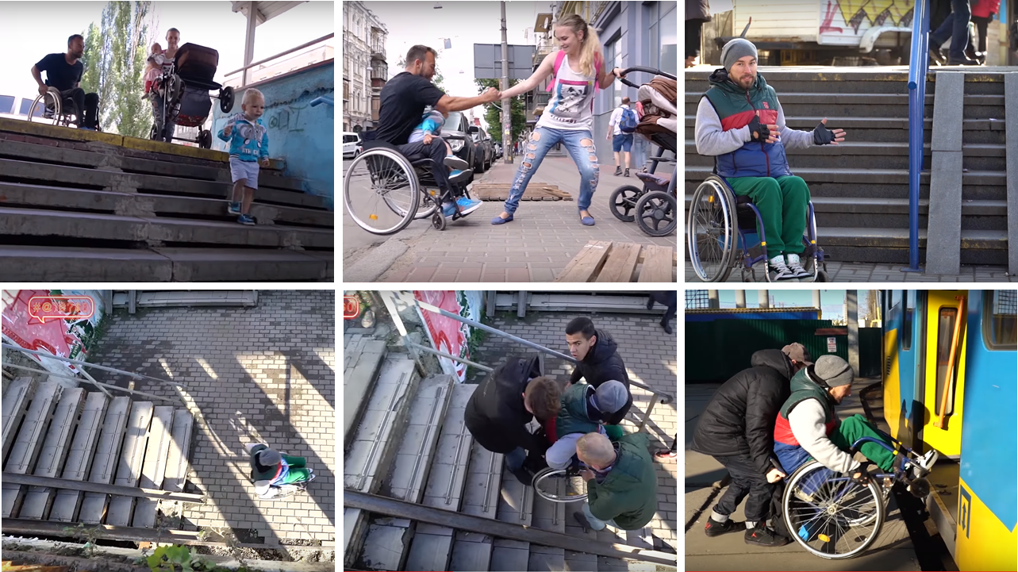
Sustainability
Open Source
$
Consultations about inclusion for businesses
Traffic
$
$
CSR
Google Partnership

Slide 7
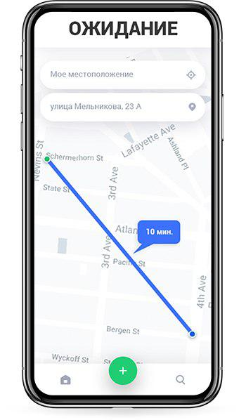
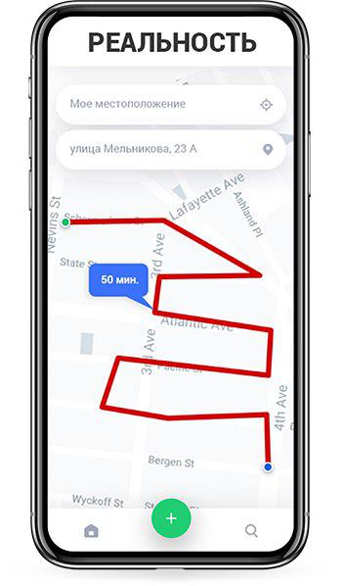
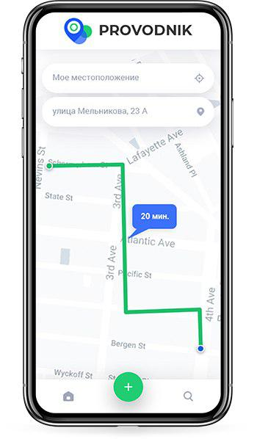
Expectations
Reality
We’ll return you 10 years of life!

Slide 8
Team Provodnik #IT4EaP
Daria Aksionova Designer, Ukraine
Anna Krys Author, Ukraine
Timur Samoylov Developer, Belarus
We’re ready for your questions!
Provodnik.now.sh

Slide 9
Q & A

